Slide 1

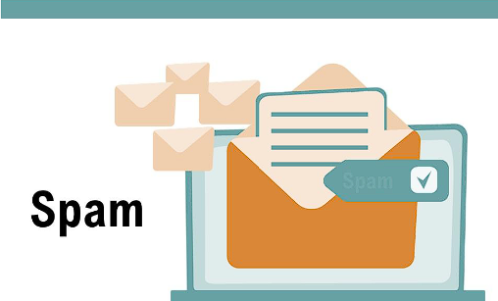

E-MAIL
SPAM
CLASSIFICATION

Slide 2

PRESENTED BY:
Samiksha Alok 21051244
Pranav Varshney 21051232
Anu Raj 2105265
Rohit Raj 2105306
Sankalp Anand 2105997

Slide 3
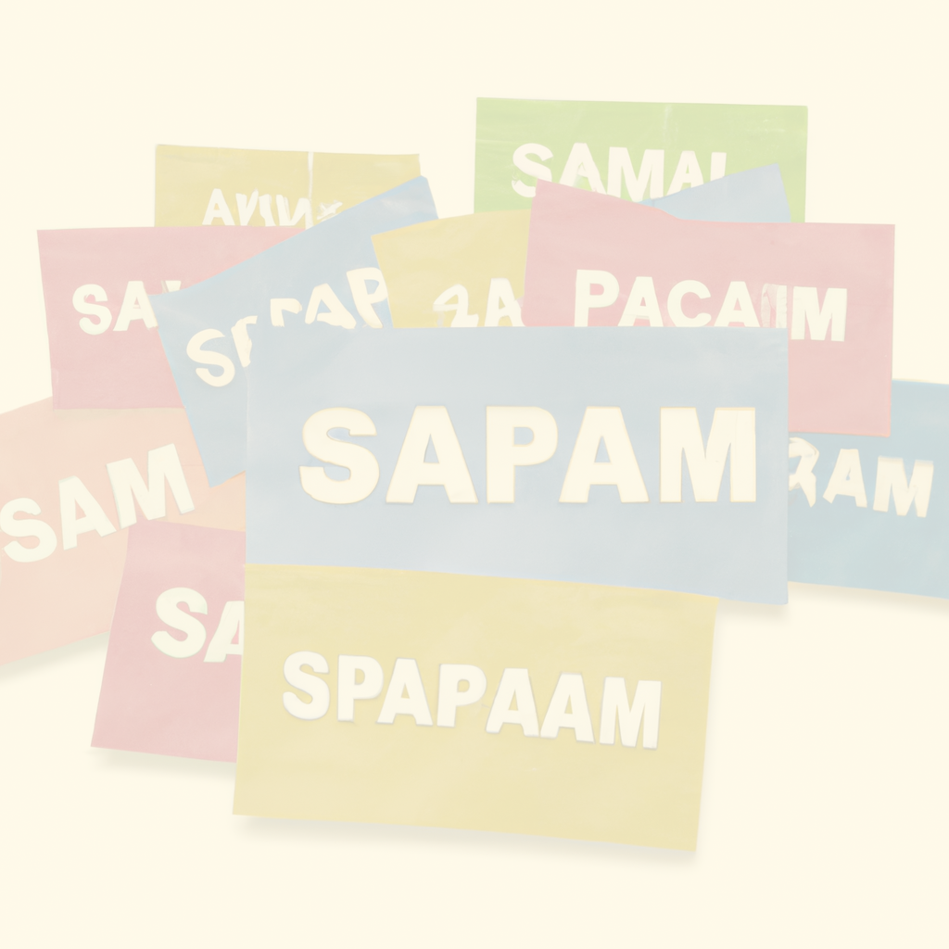
CONTENTS
Introduction
Technologies
Libraries
Machine Learning
Data set
Problem definition
Description of dataset
Methodology
Algorithms
Conclusion
References

Slide 4
INTRODUCTION
﻿In today's globalized world, email is a primary source of communication. This communication can vary from personal, business, corporate to government.
With the rapid increase in email usage, there has also been increase in the SPAM emails.
SPAM emails, also known as junk email involves nearly identical messages sent to numerous recipients by email.
Apart from being annoying, spam emails can also pose a security threat to computer system.
It is estimated that spam cost businesses on the order of $100 billion in 2007.
In this project, we use text mining to perform automatic spam filtering to use emails effectively.
We have tried to identify patterns using Data-mining classification algorithms to enable us to classify the emails as SPAM or HAM.

Slide 5
TECHNOLOGIES
Technologies used :
1. Python
2. HTML
3. CSS
4. JavaScript
Python: It has a rich ecosystem of libraries and frameworks, combined with its ease of use and readability, make it a popular choice for building end-to-end machine learning solutions, including email spam detection systems.
Libraries: 1. Numpy
2. Pandas
3. Sklearn
4. NLTK

Slide 6
LIBRARIES
1. NumPy:
It is a library for the Python programming language, adding support for large, multi-dimensional arrays and matrices, along with a large collection of high-level mathematical functions to operate on these arrays.
Moreover, NumPy forms the foundation of the Machine Learning stack.
2. Pandas:
Pandas is one of the tools in Machine Learning which is used for data cleaning and analysis.
It has features which are used for exploring, cleaning, transforming and visualizing from data.

Slide 7
Continued....
3. NLTK:
NLTK is intended to support research and teaching in NLP including empirical linguistics, cognitive science, artificial intelligence, information retrieval, and machine learning.
4. Matplotlib:
Matplotlib is a low-level library of Python which is used for data visualization. It is easy to use and emulates MATLAB like graphs and visualization.
This library is built on the top of NumPy arrays and consist of several plots like line chart, bar chart, histogram, etc.

Slide 8
DATASET
A dataset acts as an example to teach the machine learning algorithm how to make predictions. dataset as "a collection of data that is treated as a single unit by a computer".
This means that a dataset contains a lot of separate pieces of data but can be used to train an algorithm with the goal of finding predictable patterns inside the whole dataset.
How to train the data?
Al training data will vary depending on whether you're using supervised or unsupervised learning. Unsupervised learning uses unlabeled data.
Models are tasked with finding patterns (or similarities and deviations) in the data to make inferences and reach conclusions.
With supervised learning, on the other hand, humans must tag, label, or annotate the data to their criteria, in order to train the model to reach the desired conclusion (output).

Slide 9
Problem Definition
Short Message (SMS) and email has grown into a multi-billion dollars commercial industry.
SMS spam is still not as common as email spam.
The objective of this problem is to develop a machine learning system capable of accurately classifying incoming emails as either "spam" or "legitimate" (also known as "ham").
The system should be able to learn patterns and characteristics from a large dataset of previously labeled emails and generalize this knowledge to effectively identify and filter out unwanted spam emails.
The model should be able to effectively distinguish between the two classes based on the patterns and features extracted from the email data.

Slide 10
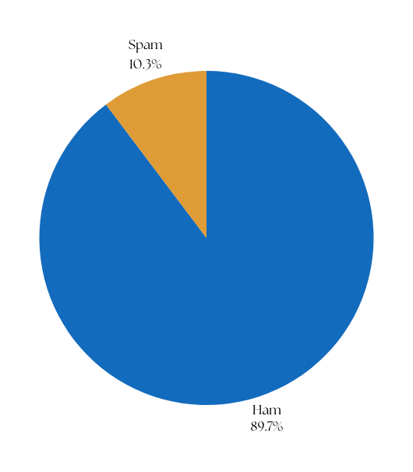
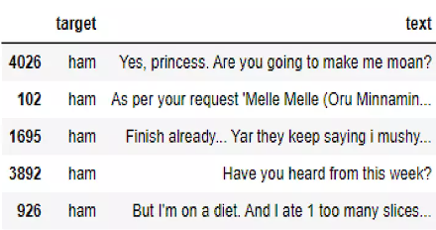
Description Of Dataset
﻿Spam email percentage in the dataset = 12.63268156424581%
Ham email percentage in the dataset = 87.37731843575419 %
The dataset consist of 5574 text message from UCI Machine learning repository

Slide 11
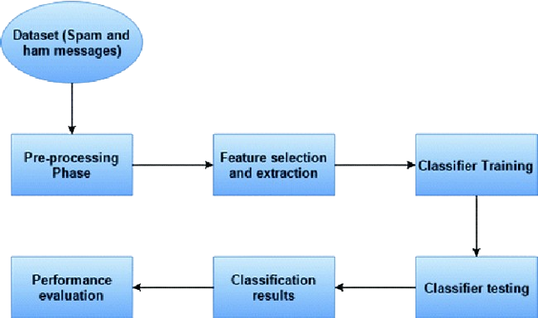
Methodology
Fig: Work flow diagram and sequence of steps taken to achieve the required results
Reference from: https://shorturl.at/akAK2

Slide 12
ALGORITHMS
﻿
Different algorithms used for email spam detection:-
1. Decision Tree Classifier
2. Naive Bayes
3. Support Vector Machines
4. K-Nearest Neighbour
5. Logistic Regression
6. Random Forests
7. Multinomial naive

Slide 13
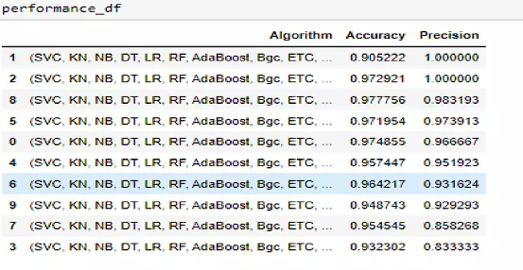
Classification of Algorithms(Naïve Bayes)
﻿NB algorithm is applied to the final extracted features.
The speed and simplicity along with high accuracy of this algorithm makes it a desirable classifier for spam detection problems.
Applying Naïve Bayes with multinomial event model to the dataset and using 10-fold cross validation results in Table 1.
Fig: Table 1,consisting of accuracy of multiple data analytic models

Slide 14
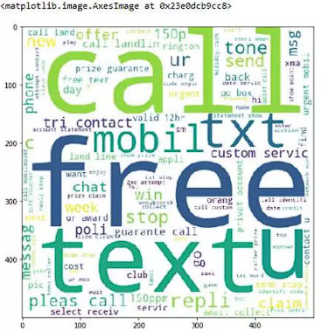
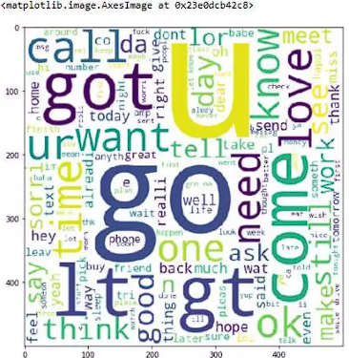
Cloud words for Ham/Spam words
Top spam words
Top ham words

Slide 15
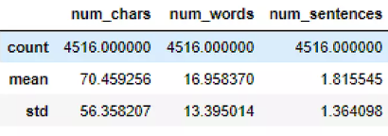
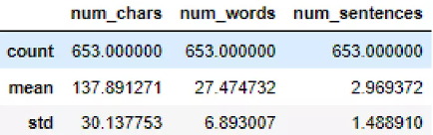
Which email is generally longer?
﻿Here, we have calculated average word count for Ham Emails and Spam Emails separately and then predicted which emails are generally longer.
Average Word Count for Ham Emails: 4516.00 words
Average Word Count for Spam Emails: 653.000 words
So, it can be concluded that, Ham emails are generally longer than spam emails.
Ham Avg.
Spam Avg.

Slide 16
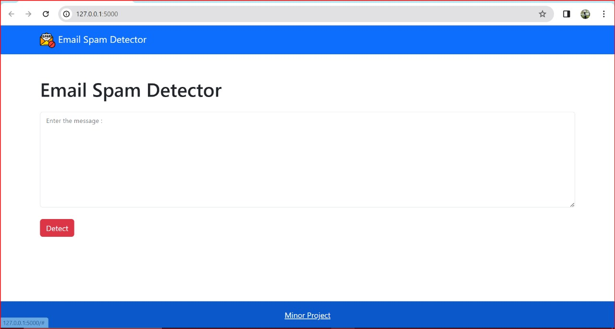
Home of application
Fig: Webpage of the spam detection website

Slide 17
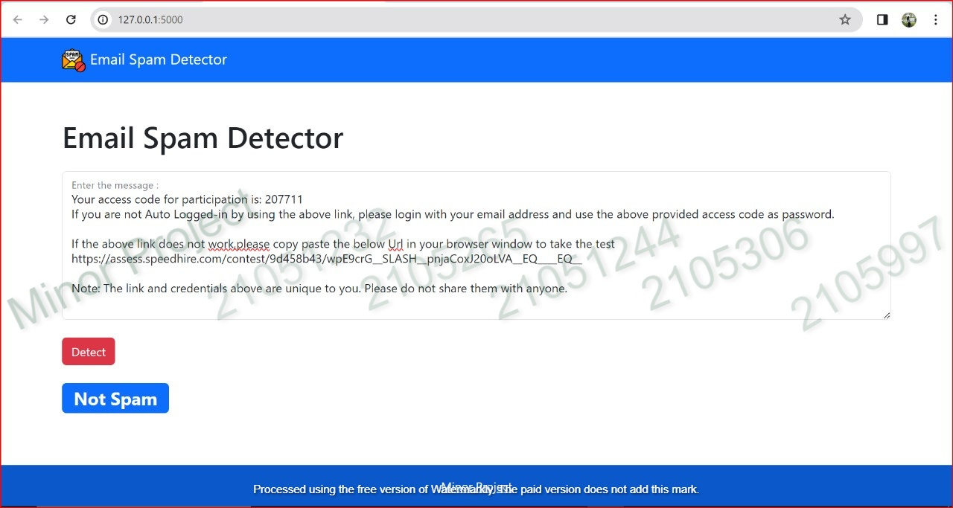
Detecting Ham Emails
Fig: Detecting and displaying the email as not spam

Slide 18
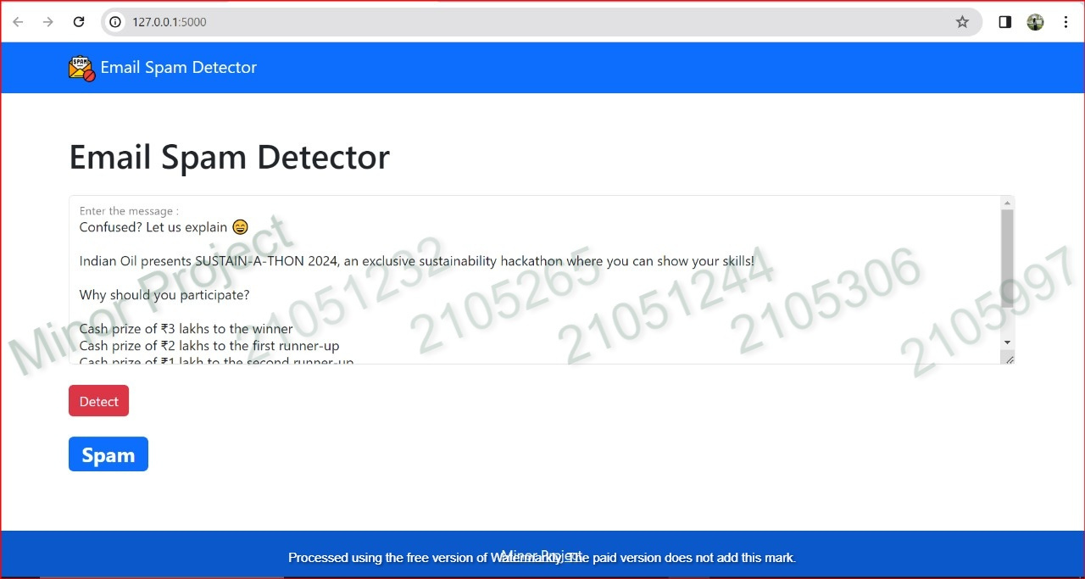
Detecting Spam Emails
Fig: Checking and displaying whether the email is spam or not

Slide 19
CONCLUSION
﻿Adaptable Spam Filters: Spam filters need to keep up as spammers constantly change their tactics. They need to be updated in real-time and use machine learning to adapt to new spam methods.
Encryption Against Quantum Attacks: As quantum computing becomes more advanced, email encryption needs to be strong enough to withstand attacks from quantum computers.
AI-Generated Spam:
Spammers will start using AI to customize spam messages.
Effective filters will be needed to tell apart genuine personalization from malicious AI-powered spam.
Malware in Spam:
Spam emails will continue to be used to spread malware. Filters must be able to identify malicious attachments and new viruses.
Blockchain Authentication: Using blockchain technology can help reduce email spoofing and phishing attempts.

Slide 20
RECENT ADVANCEMENTS AND CHALLENGES
The spam email detection domain has witnessed significant advancements with the adoption of deep learning models like RNNs, LSTMs, and transformers, as well as techniques like transfer learning, ensemble methods, adversarial training, and multimodal approaches.
However, challenges persist, including evolving spam tactics that necessitate continual model adaptation, class imbalance in datasets, concept drift over time, lack of interpretability in deep learning models, privacy and regulatory concerns surrounding email data, and the computational demands of training complex models.
Overcoming these obstacles is essential for developing robust, accurate, and explainable spam detection systems that can effectively filter unwanted emails while complying with data protection regulations and adapting to new spam strategies as they emerge.

Slide 21
FUTURE SCOPE
Modern spam filters use advanced machine learning like transformers and RNNs to better understand email content and context. This improves accuracy in identifying spam.
Quantum-Resistant Encryption: Protect emails from quantum computer attacks
AI-Driven Personalization: Differentiate between real personalization and AI-generated spam.
Adaptive Spam Tactics: Spam filters must keep evolving to counter new spamming methods.
Coordinated Spam Campaigns: Detect patterns across multiple spam sources.
Privacy-Preserving Detection: Identify spam without decrypting private email content.
The key is for spam filters to stay agile, adaptive and technologically advanced to outpace the ever-changing tactics of spammers.

Slide 22
References
﻿➤https://www.isroset.org/journal/IJSRCSE/full_paper_view.php?paper_id=444
➤ https://www.freecodecamp.org/news/send-emailsusing-code-4fcea9df63f/
➤https://www.scribd.com/doc/61315817/IntraMailing-System
➤https://www.scribd.com/doc/19518895/Researchon-Mail-System-Project-report-for-Bachelor-inComputer-Rajendra-Man-Banepali
➤ https://nevonprojects.com/email-client-project/
➤https://www.slideshare.net/47Kunalkalamkar/spam-email-detection-using-machine-learning-pptpptx
➤https://www.freeprojectz.com/python-djangoproject/mailing-system
➤ https://www.academia.edu/36614854/Spam Filtering_Using_ML_Algorithms

Slide 23


